Slide 1
“Think Different” About Compliance: Does mSCP Provide Effective macOS Compliance Configuration and Audit?
Presented by T. Boone Berlin
GSEC, GCIH, GCIA, SSAP, GCTI, GCCC, GCPM, GPEN, GDSA, GRID
Master’s Degree Candidate at the SANS Technology Institute
Notes:
This presentation discusses NIST’s new compliance and audit tool for macOS, the macOS Security Compliance Project (mSCP)
My name is Boone Berlin and I am pursuing SANS Technology Institute’s MS in Information Security Engineering.
During my time with SANS, NIST published SP800-219 Automated Secure Configuration Guidance from the mSCP in June of 2022. As a long time Mac user, this new tool piqued my interest. After a review of the document I was also intrigued by NIST’s shift away from publishing configuration guides for each macOS version. But my question was, did it live up to it’s claims to provide an automated configuration and audit tool tailored to macOS? This presentation reports my findings.
This presentation complements my SANS white paper: “Think Different” About Compliance: Is Effective, Automated macOS Configuration Achievable with NIST’s macOS Security Compliance Project?

Slide 2
Objectives
Introduce the mSCP basic structure and terminology
Explain testing method
Review test results
Show macOS Security Compliance Project (mSCP) is an effective and flexible tool for compliance management
Discuss limitations and challenges
Goal: Provide you the information required to effectively implement mSCP in your environment while alerting you of its limitations
Notes:
In order to facilitate a discussion about mSCP, we are going to go through a high level overview of how mSCP is organized and the different scripts that mSCP uses to accomplish it’s goal.
Once we have a basic understanding of how mSCP works, I will take you through my testing method. The test was designed around producing a quantitative and objective way to evaluate mSCP.
Next we will be looking at the test results. The raw data ended up being convoluted due to a number of inconsistences between the two tools, erroneous results, and false fails introduced from the test environment. I will be explaining how these issues were corrected or normalized to provide comparable and objective results.
What we will see is that mSCP is an effective tool, however we will also go through several limitations and considerations that need to be accounted for when using the tool and bringing it into your environment.
Ultimately, my goal is to provide you an intro to mSCP, give you confidence is it worth consideration for your environment, and provide you the information to hit the ground running with mSCP.
Let’s get started!

Slide 3
Why macOS Compliance?
Problems:
macOS is growing in market share at home and at work
Limited tools for macOS compliance management
Annual major version updates require agile compliance tools
macOS compliance management is set to become more of a consideration for enterprise environments
mSCP is positioned to address these problems but it’s new and untested
Notes:
So the first thing you might be thinking is why even talk about macOS? Sure, Mac has a presence with creative and home users, but rarely are those users part of a enterprise network where compliance is a concern, right? Well Mac has steadily grown in market share over the years and in 2022 has seen a significant jump, presumably related to the work from home shift after the COVID pandemic. The reality is that Macs are showing up in more enterprise environments and therefore macOS compliance needs to be considered by IT teams.
Nonetheless, compliance configuration and audit is a tedious chore that requires tools to streamline and simplify the process. However, few tools are available for macOS thanks to it’s relatively small market share compared to Windows.
Further, macOS is regularly updated on an annual cycle with ambiguous support timelines and planned obsolesce by strictly defining what versions of macOS works on which versions of Mac hardware. Industry configuration guidance is built around the much longer Windows support timelines that allow organizations to stick with a Windows version for years or even a decade. Configuration guides from recognized standards bodies are usually published after lengthy review and then maintained by incremental updates. Apple’s annual release cycle for macOS major versions means this whole process must be significantly compressed and accelerated.
mSCP represents a departure for NIST’s macOS configuration guidance through Special Publications (SP). Instead of releasing a new SP for each major macOS version, SP800-219 is intended to be a static pointer to the mSCP hosted on GitHub. Incremental changes can be rapidly promulgated through GitHub and short cuts review and publication delays. This provides a far more agile solution where changes are directly implemented into the tool and are immediately actionable. For major macOS version releases, mSCP utilizes GitHub branches to allow the mSCP tool to quickly build on the previous version’s guidance.
This feature was notable during my testing period. During macOS 13 Ventura’s Beta period, prior to CIS even publishing a draft version of their benchmark for Ventura, mSCP had a branch up and working that used macOS 12 Monterey’s Benchmark as a starting point.
This all sounds great, so what’s the catch? mSCP has only been published for for about 6 months and is untested. Is it effective? Is it really automated? Well that’s what here to learn.

Slide 4
mSCP Structure and Terminology
GitHub repository organized around branches named for macOS versions
usnistgov/macos_security
baselines
build
includes
rules
scripts
Notes:
For the purposes of my test, I chose the CIS Level 2 Benchmark, so all my examples refer to that standard. There are other configuration guides included in mSCP and can be found in the baselines directory of the branch you are working with. Everything I am speaking about in this section is applicable to the other standards.
As a note, during the presentation I will be referring to benchmarks and baselines. Benchmarks refer specifically to the published CIS benchmarks while baseline refers to the YAML files that mSCP uses to implement those benchmarks.
To get started, after you have installed mSCP on your system, you’ll need to choose the branch you’re working from based on the version of macOS you are using. mSCP supports 10.15 Catalina, 11 Big Sur, 12 Monterey, and 13 Ventura.
There are 5 directories within the project that we’ll discuss, there are others that you can explore on your own, but these 5 are the most important to getting started with mSCP.
Baselines: As mentioned before, this is where the various configuration guides included in the branch you are working with are provided.
Build: There are several python scripts provided by mSCP to generate the tools used to evaluate and configure your system. These tools are located in the build directory. We’ll come back to this later on this slide.
Includes: There are some aspects of mSCP that require additional tools or files to configure your system. These are located in this directory. We’ll come back to this later in the presentation when we talk about password configuration.
Rules: All the individual rules (controls in CIS parlance) referenced to in the baselines are located in this directory. The are organized by category: audit, auth, icloud, os, pwpolicy, supplemental, and sysprefs. The supplemental category will come in to play later in the presentation.
Scripts: Here we will find the python scripts I referred to earlier. These are the first step to getting started with mSCP. We’ll talk about 2 of the scripts, although there are others provided by mSCP.

Slide 5
mSCP Structure and Terminology
GitHub repository organized around branches named for macOS versions
usnistgov/macos_security
baselines
build
includes
rules
scripts
generate_baseline.py
generate_guidance.py
Notes:
Under the scripts directory, we’ll find the generate_baseline.py script and the generate_guidance.py. Invoking the generate_baseline.py script with your selected baseline as an option will produce a duplicate baseline under the build directory. This allows modification of your selected baseline without affecting the original. The script can also aid in producing fully custom baselines.

Slide 6
mSCP Structure and Terminology
GitHub repository organized around branches named for macOS versions
usnistgov/macos_security
baselines
build
includes
rules
scripts
baselines
cis_lvl2.yaml
generate_baseline.py
generate_guidance.py
Notes:
Here we see invoking the generate_baseline.py has produced a duplicate baseline located at build/baselines/cis_lvl2.yaml
Next we’ll invoke generate_guidance.py script pointed at the baseline we created with the generate_baseline.py scsript.

Slide 7
mSCP Structure and Terminology
GitHub repository organized around branches named for macOS versions
usnistgov/macos_security
baselines
build
includes
rules
scripts
baselines
cis_lvl2.yaml
cis_lvl2
generate_baseline.py
cis_lvl2_compliance.sh
generate_guidance.py
mobileconfigs
preferences (mSCP .plist)
preferences (sys config .plist files)
unsigned (or signed) (.mobileconfig files)
Notes:
Now we see a number of new directories have been created by the generate_guidance.py script.
Of note, I do not show the reports generated by mSCP on the slide, but a report tailored to your selected baseline is produced in several format and are located under build/cis_lvl2.
cis_lvl2_compliance.sh is the script that actually audits and/or configures your system against the CIS Level 2 baseline. Several options for this script exist: check only, fix only, check and fix, interactive mode, and non-interactive mode.
The mobileconfigs directory contains automatically generated Configuration Profiles used to configure your system. These can be produced as signed Configuration Profiles with some additional options added to the generate_guidance.py script.
Finally, note there are two different preferences directories created. build/cis_lvl2/preferences contains a .plist file used to mark rules included in your selected baseline as approved exceptions for organization specific configuration policies. build/cis_lvl2/mobileconfigs/preferences contains .plist files that can be used with some MDM solutions for automated configuration.
You’ll note that there are several steps on the command line required simply to get to the point of being able to audit and configure your system. It’s my opinion, that mSCP should streamline this process by offering an additional script with more comprehensive options and calls the scripts discussed to improve efficiency by collapsing these 2 steps into one. Alternatively, there is an opportunity here for custom scripting within your organization.

Slide 8
mSCP Testing Methodology
4 VMs running macOS versions: 10.15 Catalina, 11 Big Sur, 12 Monterey, and 13 Ventura
CIS Level 2 Benchmark for each respective macOS version
Notes:
As discussed before, the goal on my testing was to provide quantifiable and objective results. This was accomplished by testing mSCP audits and configuration against a recognized audit tool. Nessus was selected as the standard mSCP would be measured against. 4 VMs were created with the 4 versions of macOS supported by mSCP. As mentioned before, all testing was performed used CIS Level 2 benchmarks for the applicable system.

Slide 9
mSCP Testing Methodology
4 VMs running macOS versions: 10.15 Catalina, 11 Big Sur, 12 Monterey, and 13 Ventura
CIS Level 2 Benchmark for each respective macOS version
Establish Reference System
Notes:
A reference state was created across the 4 test systems. The goal here was to establish as much similarity between the 4 test systems as possible with the tools for the test installed but in an unconfigured state. Of note, several configurations for the test environment were required that might not be considered good practice, for example: enabling the root user and enabling ssh.

Slide 10
mSCP Testing Methodology
4 VMs running macOS versions: 10.15 Catalina, 11 Big Sur, 12 Monterey, and 13 Ventura
CIS Level 2 Benchmark for each respective macOS version
Establish Reference System
Audit Reference System with mSCP & Nessus
Notes:
Next the reference systems were audited using both Nessus and mSCP. This essentially provides an “out-of-the-box” security evaluation.

Slide 11
mSCP Testing Methodology
4 VMs running macOS versions: 10.15 Catalina, 11 Big Sur, 12 Monterey, and 13 Ventura
CIS Level 2 Benchmark for each respective macOS version
Establish Reference System
Audit Reference System with mSCP & Nessus
Configure System with
mSCP
Notes:
Next each system was configured using mSCP to the CIS Level 2 baseline. Note that the baseline used in the test had to modified to remove rules that disabled the root user and disabled ssh. Otherwise post configuration audits would have been impossible. This modification also removed those rules for audit and there for these out-of-compliance configurations were not reported by mSCP.
Configuration consisted of 3 steps:
Invoking the cis_lvl2_compliance.sh script with the fix option
Manually installing the automatically generated Configuration Profiles (ideally this would be accomplished by custom scripts, scripted by mSCP, or managed by a MDM solution)
Manually installing and configuring the provided pwpolicy.xml in the includes directory (ideally this would be accomplished by custom scripts or scripted within mSCP)
One rule prescribed by the baseline was tagged as a manual rule and was not implemented since the test was designed to evaluate automatic aspects of mSCP.
You may question why some “manual” steps were taken while others were not. Automatically generated Configuration Profiles and the provided pwpolicy.xml file are a significant part of what mSCP provides to simplify and streamline the configuration process for an organization. Not including these aspects in the test would have missed an opportunity to evaluate all that mSCP provides. However, a significant improvement to the mSCP would be scripting these steps to more fully automate the configuration process.

Slide 12
mSCP Testing Methodology
4 VMs running macOS versions: 10.15 Catalina, 11 Big Sur, 12 Monterey, and 13 Ventura
CIS Level 2 Benchmark for each respective macOS version
Establish Reference System
Audit Reference System with mSCP & Nessus
Configure System with
mSCP
Audit Configured System with mSCP & Nessus
Notes:
Finally the configured systems were audited once again with Nessus and mSCP to determine the effectiveness of the mSCP configuration.
More detail about the test design and setup is provided in my whitepaper.

Slide 13
Results
Notes:
Take a moment to review the data presented in the graph.
Note that only macOS 12 Monterey data is presented, this was a decision based on choosing the most recent macOS version with consistent data produced from the test. More details on this decision along with the raw data from all the test systems are available in my white paper.
On the far right of each bar are the total number of rules or controls evaluated by the tool.
mSCP only reports pass and fail results, while Nessus reports pass, fail, and warnings.
The challenge in evaluating the raw data is that we are not comparing apples to apples between the two tools. As a result, I have normalized the data to provide a more objective and realistic representation of mSCP’s effectiveness. This is what the third pair of bars on the graph report. Normalization was necessary due to the following factors:
mSCP provided v1.1.0 of the macOS 12 Monterey CIS Level 2 Benchmark while Nessus provided v1.0.0.
The 2 tools handle CIS Manual rules differently
Nessus reported 25 false fails or warnings
The testing environment caused fails that were not representative of an actual system in a production environment
mSCP also had 2 false fails and are part of the 3 fails reported in the normalized mSCP data. mSCP also reported 5 false passes and are part of the 99 passes in the normalized data. Since mSCP is the tool being evaluated these were not corrected. However, this indicates mSCP is more accurate tool than Nessus for macOS albeit one that still requires a second audit tool for results validation.

Slide 14
mSCP Data Normalization
1 fail moved to pass due to test environment
2 rules added after being removed to support testing
Notes:
Step-by-step explanation of how mSCP data was normalized
More detail about the normalization procedure is provided in my whitepaper.

Slide 15
Nessus Data Normalization
6 warnings and 4 fails removed due to CIS benchmark version change
Notes:
Step-by-step explanation of how Nessus data was normalized

Slide 16
Nessus Data Normalization
6 warnings and 4 fails removed due to CIS benchmark version change
3 fails moved to warnings due to different ways Nessus and mSCP handle CIS ”manual” controls
Notes:
Step-by-step explanation of how Nessus data was normalized

Slide 17
Nessus Data Normalization
6 warnings and 4 fails removed due to CIS benchmark version change
3 fails moved to warnings due to different ways Nessus and mSCP handle CIS ”manual” controls
23 fails and 2 warnings moved to pass due to erroneous findings verified to be in compliance
Notes:
Step-by-step explanation of how Nessus data was normalized

Slide 18
Nessus Results Normalization
6 warnings and 4 fails removed due to CIS benchmark version change
3 fails moved to warnings due to different ways Nessus and mSCP handle CIS ”manual” controls
23 fails and 2 warnings moved to pass due to erroneous findings verified to be in compliance
3 fails moved to pass due to test environment
Notes:
Step-by-step explanation of how Nessus data was normalized
More detail about the normalization procedure is provided in my whitepaper.

Slide 19
Results
Marked improvement reported by both tools - mSCP is an effective configuration tool
Normalized Nessus results are the most realistic assessment of system compliance but required correcting 25 false fails or warnings
mSCP audit reporting is optimistic without additional analysis, only reported 2 false fails, but reported 5 false passes.
Notes:
Comparing the compliance score improvement for both tools shows a clear and marked improvement. mSCP is effective as a configuration tool. However, it would benefit from additional scripting to get it closer to being a fully automated solution.
The normalized Nessus data represents the most realistic assessment of the system and shows that mSCP reports an optimistic compliance score for the system. The reasons and mitigations for this will be discussed next.
Of note, false fails were reported for both tools: mSCP only reported 2, while Nessus reported 25.
On the other, hand Nessus reported no false passes but mSCP reported 5 false passes that were found by Nessus.
From a risk perspective, it is preferred that a tool report a more secure environment as less secure than it actually is compared to an unsecure environment being reported as more secure than it is. The latter risks unknown liabilities and vulnerabilities while the former represents man-hours lost unnecessarily tracking down failed audit findings. These are important considerations for both risk sensitive and cost sensitive organizations.

Slide 20
mSCP Considerations and Limitations
mSCP reporting does not include CIS manual controls
Lists manual controls in rule located in path: /rules/supplemental/supplemental_cis_manual.yaml
This leads to optimistic reporting and requires additional evaluation prior to reporting results
Review supplemental rules files and determine if they are applicable to your selected baseline and environment before publishing mSCP reports
Notes:
mSCP reporting is optimistic due to not reporting the rules (CIS controls) that do not have automated audit and configuration methods.
CIS Benchmarks lists certain controls as “manual.” Some of these controls are completely manual, while others may have automated (CLI commands) methods for audit but not for configuration.
Nessus reports controls that have no automated methods as warnings to alert that further investigation is required. CIS controls that have automated audit methods (but no automated configuration) are checked by Nessus and reported as pass or fail.
mSCP on the other hand does not report any CIS manual controls in it’s audit scoring. Instead it lists these controls in a supplemental rule.
As an example, if the CIS Benchmark lists 100 controls but 10 of those are completely manual and 10 of those only had automated audit methods then the best score Nessus would report is 90% compliant with 10 warnings. mSCP’s best score, on the other hand, would be 100% (in reality an 80% score against the benchmark) and expect the auditor to review the supplemental to ensure the target system is actually at 100%.
Additionally, mSCP fails to implement a mechanism to report on manual controls that have automated audit methods and relegates all CIS manual controls to manual investigation via the supplemental rule and consulting the benchmark.
It is my opinion that these 2 points represent a significant flaw in mSCP’s design and should be addressed.

Slide 21
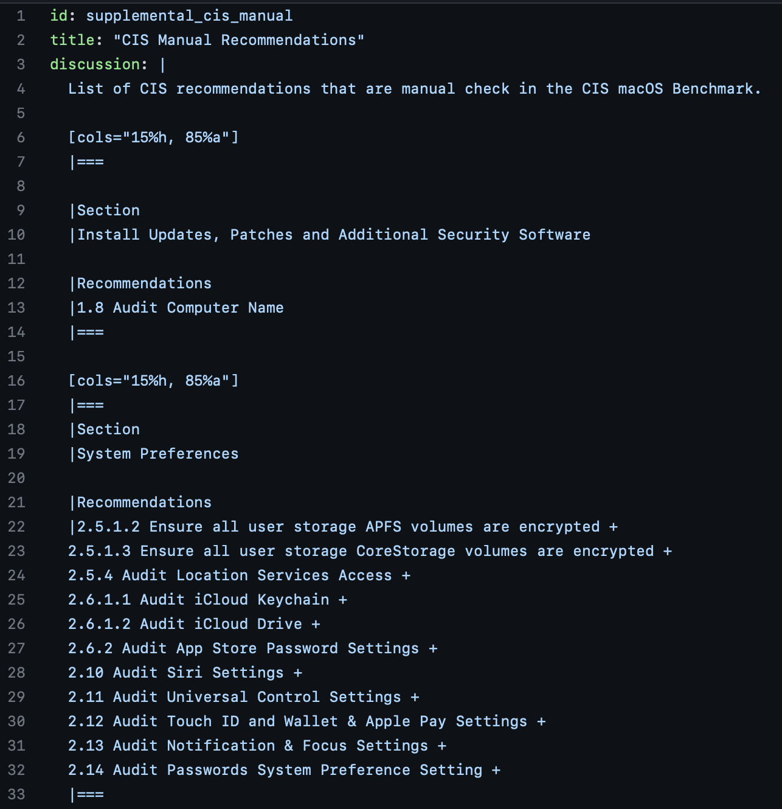
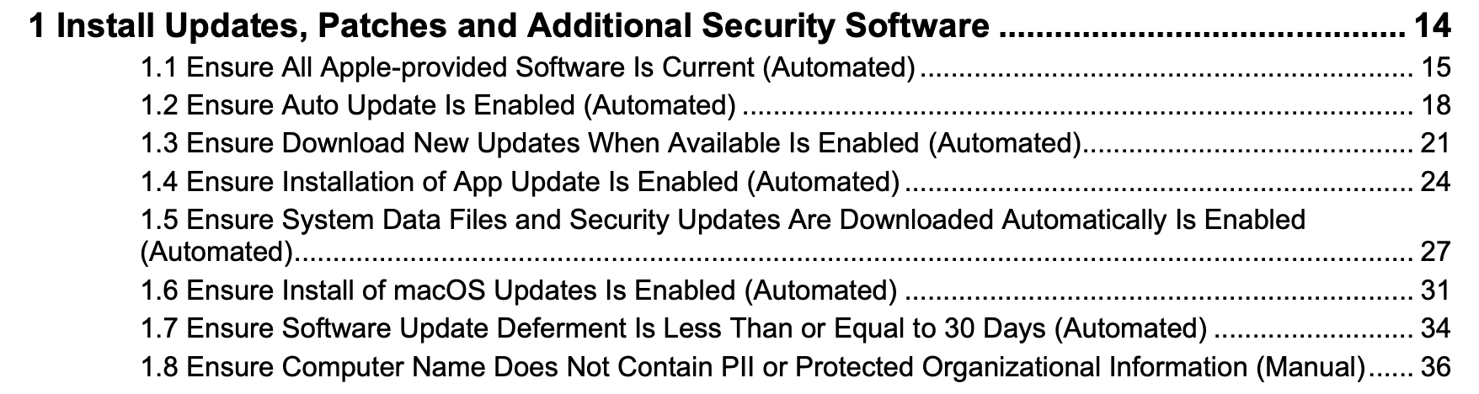
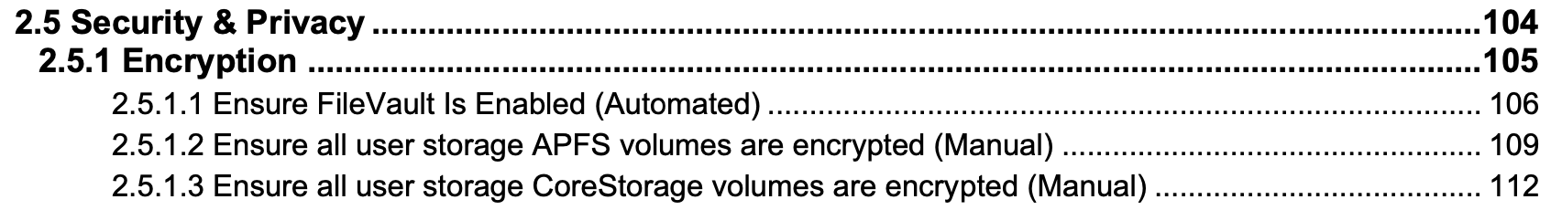
CIS Manual Controls
Notes:
CIS Manual Controls Graphic

Slide 22
mSCP Considerations and Limitations
mSCP has it’s own manual rules separate from CIS manual controls
These rules are not consolidated and are only noted in the ”tags” section within the individual rule .yaml files
mSCP manual rules change from branch-to-branch
Manual rules are not automatically configured and will result in failures even after configuration.
Review and cross-check rules in your baseline against rules tagged as manual
Notes:
Separate from CIS manual rules, mSCP also defines it’s own manual rules. These rules are not consolidated in a supplemental rule or similar list and require the auditor to review what rules in their baseline are tagged as manual. Grep is useful here.
An alert that manual configuration is required for these rules would benefit the user.

Slide 23
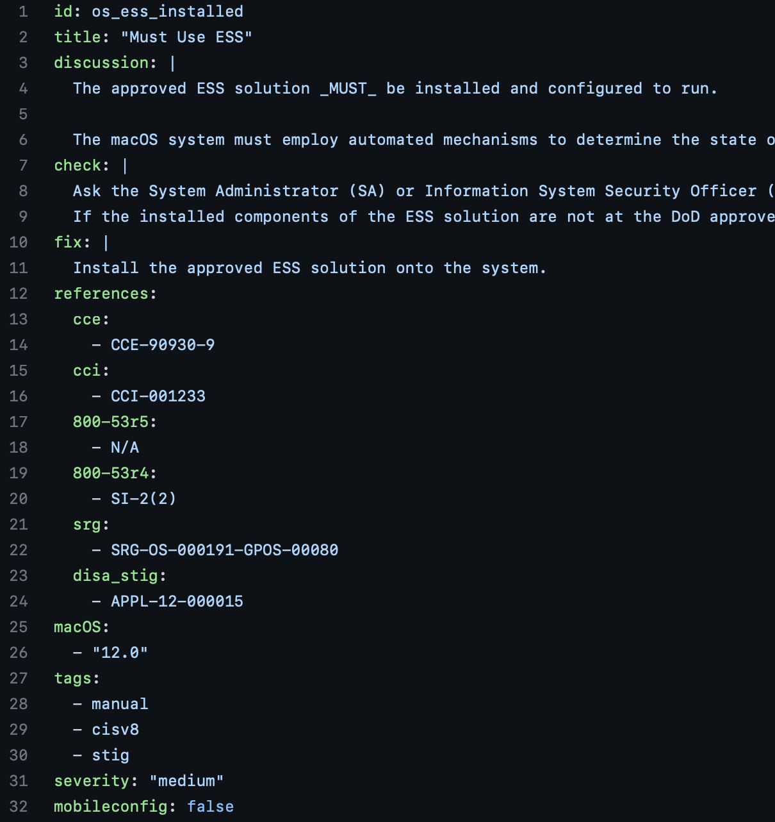
mSCP Manual Rules
This rule is not applicable to the CIS Level 2 Benchmark but is only provided as an example.
% grep -nR "\- manual" rules
rules/os/os_ess_installed.yaml:28: - manual
rules/os/os_filevault_authorized_users.yaml:33: - manual
rules/os/os_certificate_authority_trust.yaml:31: - manual
rules/pwpolicy/pwpolicy_temporary_or_emergency_accounts_disable.yaml:79: - manual
rules/sysprefs/sysprefs_wifi_disable.yaml:48: - manual
Notes:
mSCP Manual Rules Graphic

Slide 24
mSCP Limitations and Considerations
Configuration is not fully automated
mSCP relies on 4 mechanisms for configuration
Scripted Configuration Commands
Configuration Profiles (.mobilconfig files)
pwpolicy.xml file
Manual configuration
Configuration Profiles are cumbersome to install without a MDM or additional scripting
pwpolicy.xml provided in the /includes directory with instructions for use contained in: /rules/supplemental/supplemental_password_policy
Notes:
While SP800-219 touts mSCP as an “Automated Configuration Guidance” solution, it still requires a good deal of manual configuration.
Configuration Profiles are automatically generated based on your selected baseline but installing them manually is a painstaking one-at-time process. In the case of macOS 12 Monterey CIS Level 2 baseline, 15 individual configuration profiles are generated. Installing each one required 5 clicks in the macOS System Preferences Profiles Pane. This is completely unsustainable for any sizable organization. MDM solutions provide options for distributing Configuration Profiles to users but an automated batch installation option would be a far better solution. This may be an issue that Apple needs to address in their OS development since Profiles Pane did not allow batch profile installation through the GUI and a Terminal command that, at one time, allowed batch profile installation with CLI tools has apparently been removed from Developer Tools.
Installing and using pwpolicy.xml involves several steps that should be scripted to the improve efficiency of configuring a target system. Steps include the following:
Saving the provided pwpolicy.xml file from the includes directory to an appropriate location on the target system
Running the command listed in supplemental_password_policy rule to configure the new password policy on the system
Update the variable field in the cis_lvl2_compliance.sh script with the location of the new password policy file prior to running the script with the fix or check option. (Instructions for this step are located in scripts/KNOWN_ISSUES)
In my opinion, these steps could be part of the options in the cis_lvl2_compliance.sh script or read from input when running the script interactively.

Slide 25
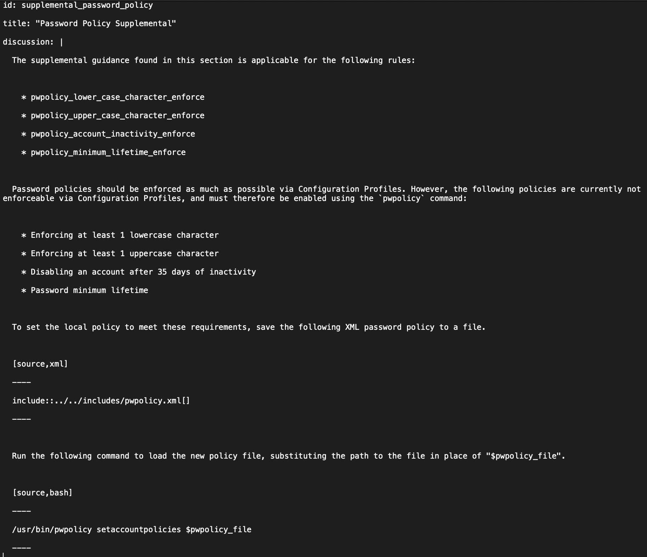
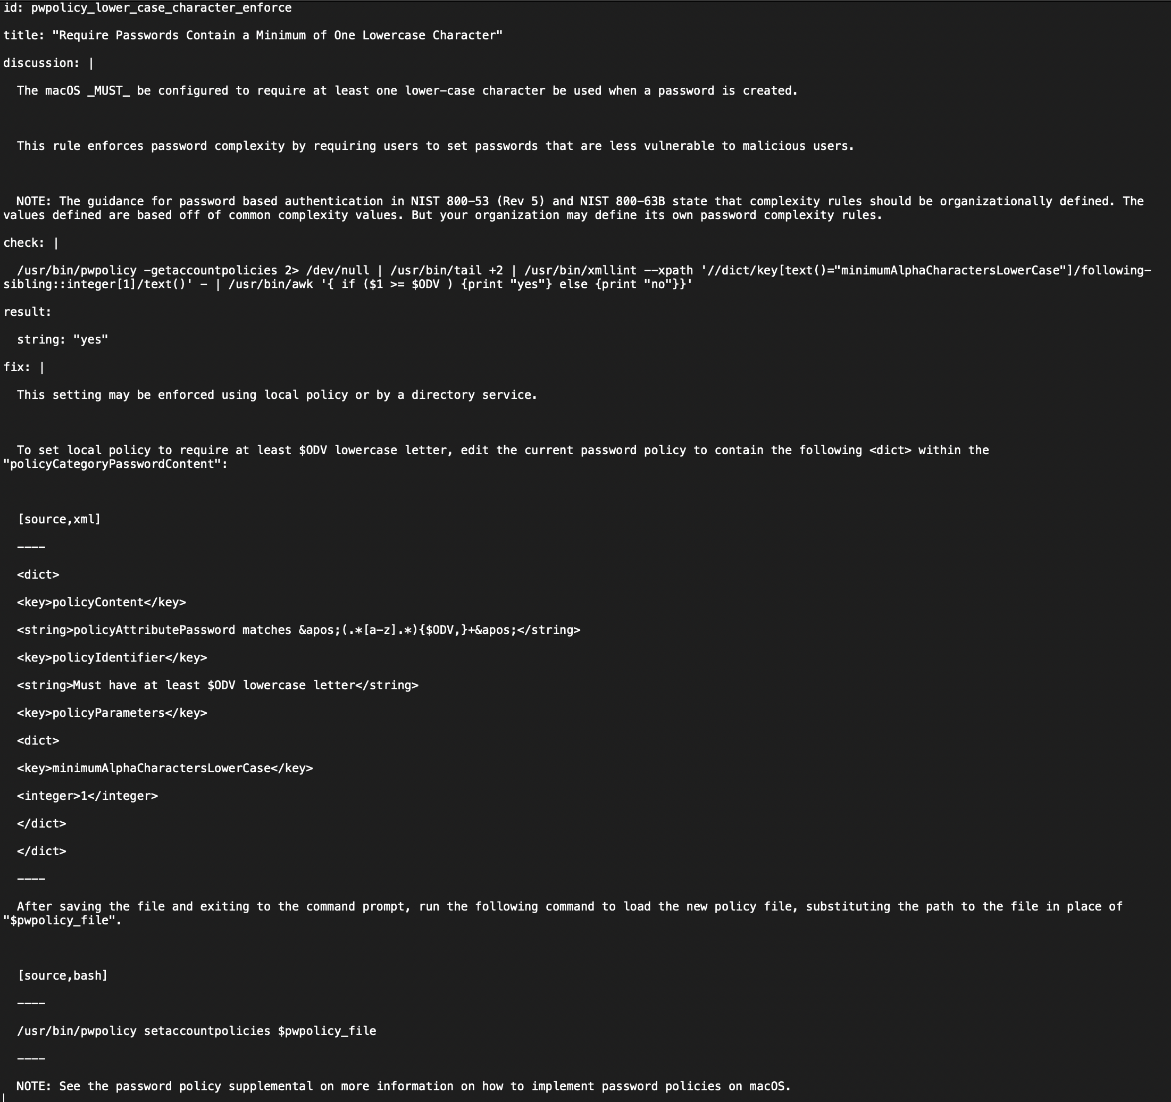
pwpolicy.xml
Notes:
pwpolicy.xml Graphic

Slide 26
mSCP Suggested Improvements
Improve overall workflow for better efficiency with additional scripting
Automate Configuration Profile installation
Automate pwpolicy.xml file installation and configuration
Address false fails and false passes for improved accuracy
Implement a reporting mechanism to alert on CIS manual controls
Utilize automatic audit checks in CIS manual controls
Report fails that result from mSCP manual rules with an alert that manual configuration is required
Notes:
See Slide 7 and notes
See Slides 11 and 24 and notes
See Slides 11 and 24-25 and notes
See Slides 13 and 19 and notes
See Slides 19-21 and notes
See Slides 20-21 and notes
See Slides 22-23 and notes

Slide 27
Summary
Problem: mSCP is a promising but untested tool
Proves to be an effective configuration tool but could be more fully automated
mSCP audit reporting is optimistic without additional analysis
A second audit tool is recommended to validate reporting
Overall a solid and useful tool that is easy to improve and build on with excellent support from it’s authors
Worthy of a look for macOS compliance in your environment
Notes:
T. Boone Berlin
www.linkedin.com/in/tbooneberlin

